Slide 1
Raspberry Pi
Day 3

Slide 2
Adding onscreen keyboard:
$ sudo apt-get install matchbox-keyboard
$ cd Desktop
$ sudo nano keyboard.sh
#!/bin/bash
Matchbox-keyboard
$ sudo su // admin
$ chmod +x keyboard.sh // changing file permission
$ exit

Slide 3
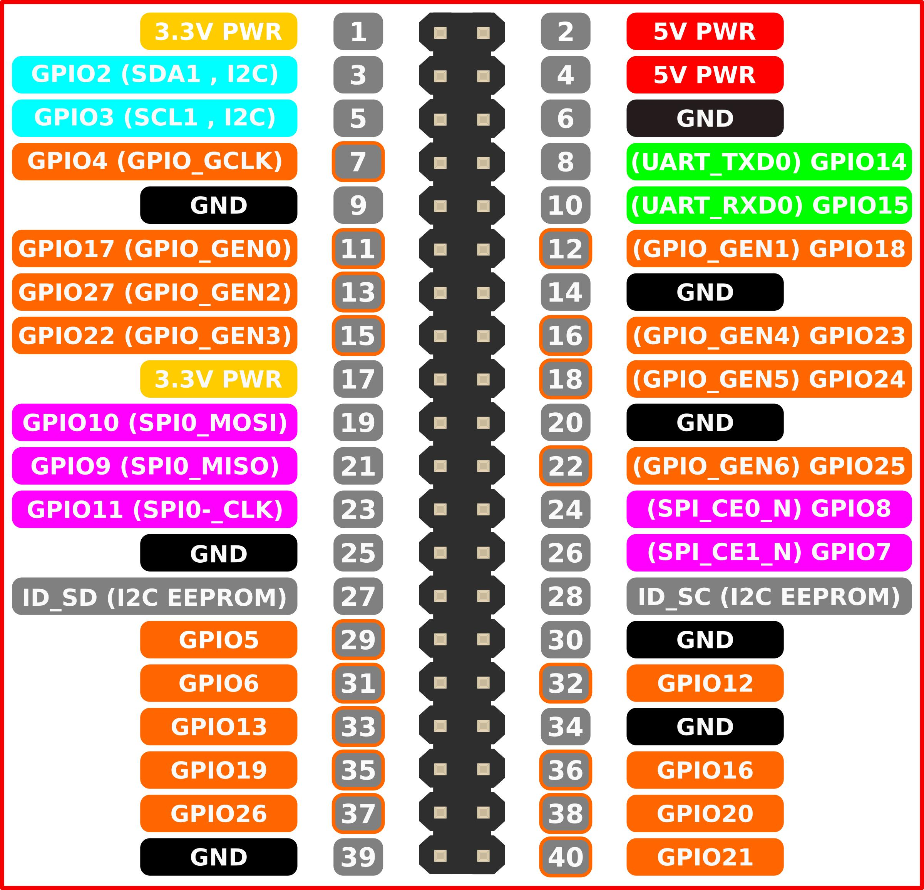

Slide 4

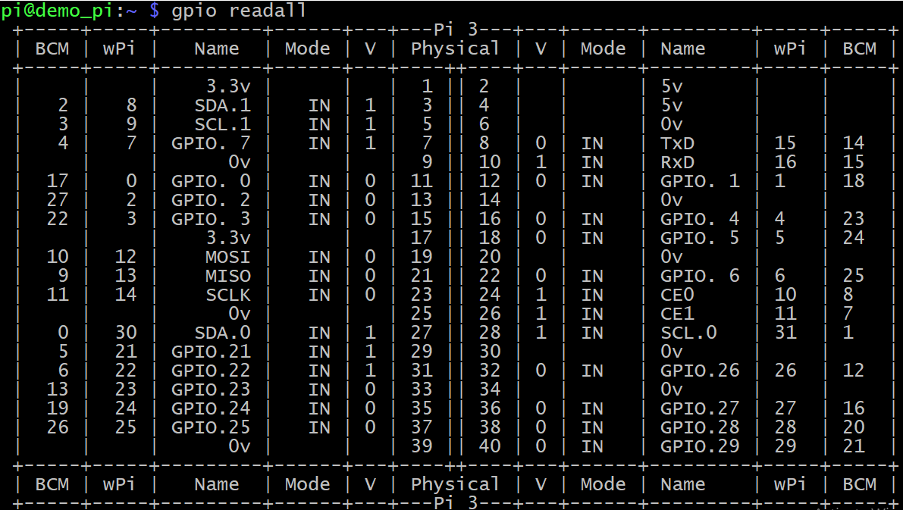

Slide 5
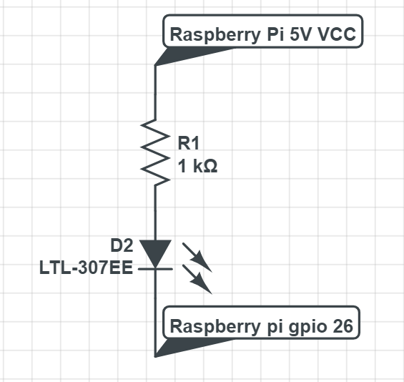
Raspbery Pi : LED Circuit

Slide 6
Raspberry pi : GPIO
$ sudo apt-get install python-rpi.gpio
Install gpio support for raspberry pi
$ cd ~
$ mkdir example
$ mkdir gpio
$ sudo nano led1.py
import Rpi.GPIO as gpio
import time
gpio.setmode(gpio.BCM) [Broadcom name : gpio number]
gpio.setup(26, gpio.OUT)
temp_var = 5

Slide 7
Raspberry pi : GPIO
while temp_var:
temp_var -= 1
gpio.output(26, gpio.HIGH)
time.sleep(0.500)
gpio.output(26, gpio.LOW)
time.sleep(0.500)
gpio.cleanup()
Printf(‘GPIO ran fine and cleaned up’)

Slide 8
Raspberry pi : GPIO (cont.)
$ cd ~
$ mkdir example
$ mkdir gpio
$ sudo nano led2.py
import Rpi.GPIO as gpio
import time
#[Broadcom name : gpio number]
gpio.setmode(gpio.BCM)
gpio.setup(26, gpio.OUT)
delay = 0.5 # in seconds
temp_var = 20

Slide 9
Raspberry pi : GPIO (cont.)
while temp_var:
temp_var -= 1
gpio.output(26, gpio.HIGH)
time.sleep(delay)
gpio.output(26, gpio.LOW)
time.sleep(delay)
# decrease 50ms each time reach here
delay -= 0.020
gpio.cleanup()
Printf(‘GPIO ran fine and cleaned up’)

Slide 10
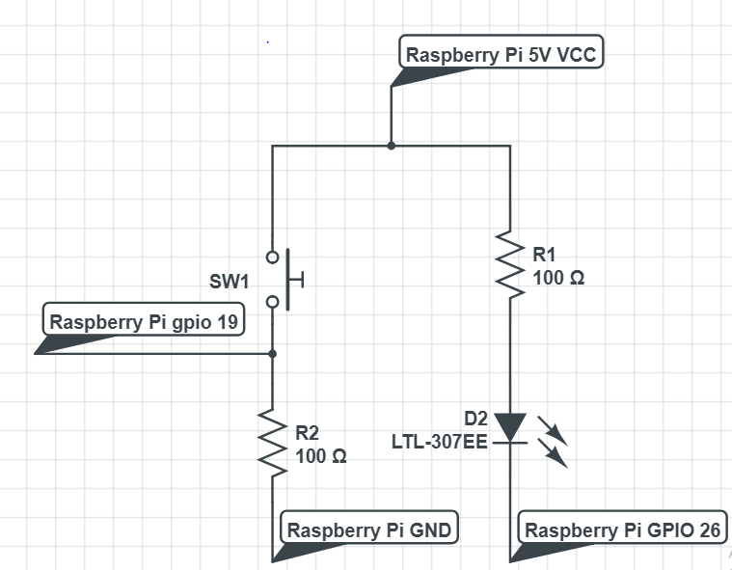
Raspberry Pi : GPIO button

Slide 11
Raspberry Pi : GPIO button (cont.)
$ cd ~
$ cd /example/gpio
$ sudo nano button.py
import Rpi.GPIO as gpio
import time
gpio.setwarnings(False)
gpio.cleanup()
gpio.setmode(gpio.BCM)
gpio.setup(26, gpio.OUT)
gpio.setup(19, gpio.IN)

Slide 12
Raspberry Pi : GPIO button (cont.)
while true:
if gpio.input(19) == True:
blink_times = 3
while blink_times:
blink_times -= 1
gpio.output(26, False)
time.sleep(0.2)
gpio.output(26, True)
time.sleep(0.2)
time.sleep(0.01)

